Slide 1
Review
Insights
December 5, 2024
By: Juan Alvarado

Slide 2
Introduction
December 5, 2024

Slide 3
Motivation
December 5, 2024
App Reviews can provide useful, timely insights into problems with applications.
Production data on what app is doing well, what can be improved
Actionable items (user stories) can be obtained from reviews not only on the app being developed, but from reviews of competing apps, as well.

Slide 4
Problem to Solve
December 5, 2024
Apps (especially popular apps) get hundreds of reviews every day.
Reading through and analyzing is time-consuming and manual
A tool could be created to automatically extract insights from reviews of several apps quickly
Single out most-positive/most-negative reviews, and provide a quick summary.

Slide 5
Techniques & Implementation
December 5, 2024

Slide 6
Techniques
December 5, 2024
Python GUI for the Review Insights application created using Tkinter library.
User prompted to search for an app via name, then top 5 results are shown.
Application web-scrapes the 1000 most recent reviews for app.
Reviews are ran through sentiment analysis algorithm, ranked, and summarized.

Slide 7
Implementation
December 5, 2024
All application data comes from Google Play store, via Google Play Scraper (Jo Mingyu, PyPi).
Sentiment Analysis done via Natural Language Toolkit (NLTK), specifically SentimentIntensityAnalyzer.
Summarizer AI model brought in from HuggingFace: Facebook’s BART summarizing model trained on CNN and Daily Mail articles.

Slide 8
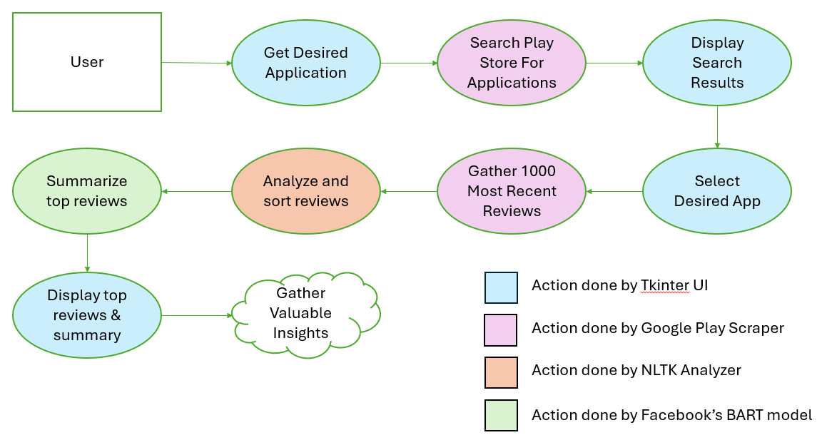
Design Diagram
December 5, 2024

Slide 9
Evaluation
December 5, 2024

Slide 10
December 5, 2024
Live Demo

Slide 11
Question & Answer
December 5, 2024

Slide 12
Thank You!
December 5, 2024

Slide 13
Bibliography
December 5, 2024
Hasija , S. (2021, July 16). Play store app reviews scrapper (daily update). Kaggle. https://www.kaggle.com/code/odins0n/play-store-app-reviews-scrapper-daily-update
Mulla, R. (2022, May 5). Sentiment Analysis Python 🤗 [youtube tutorial]. Kaggle. https://www.kaggle.com/code/robikscube/sentiment-analysis-python-youtube-tutorial
Chaumond, J, et. al. (2024, February 13). Facebook/Bart-Large-CNN · hugging face. AI at Meta · Hugging Face. https://huggingface.co/facebook/bart-large-cnn
Mingyu, J. (2024, June 6). Google-play-scraper. PyPI. https://pypi.org/project/google-play-scraper/
NLTK. (2023, January 2). nltk.sentiment.SentimentIntensityAnalyzer. https://www.nltk.org/api/nltk.sentiment.SentimentIntensityAnalyzer.html?highlight=sentimentintensity

